Slide 1

Welcome
Notes:
Topic: Energy Management
Time: 30 minutes
Purpose of training evolution: Sailors will explore how to raise, lower, and regulate their energy levels to meet the demands of challenging situations effectively with a Warrior Mindset.
Expected outcome of training evolution: Sailors intentionally maintain self-awareness in their daily lives to regulate appropriate energy and meet the demands of the current event.
Safety: Inform Sailors of safety hazards in the training environment. For some topics, Sailors should be informed if there is a designated person to talk to if the Sailor feels compelled to leave the training.
Facilitator Actions:
Display slide.
Greet Sailors.
Introduce yourself and give any background on yourself that might be of interest.
Establish credibility.
Facilitator Instructions:
The slide deck acts as a guide to present a facilitated discussion that may include activities.
Best practice: Use the slide to develop interest in the subject matter. Do not read the slides word for word. The Sailors should be able read the text and understand the messaging presented in the graphics.
Facilitator notes are available for each slide to help the Facilitator deliver the topic.
Best practice: Use the Slide Show view to ensure the Facilitator notes are viewable.
The Facilitator notes are divided into general instructions for Facilitator Actions (mechanics of facilitation) and the Facilitator Content (Inform, Discuss, Perform, and Reference).
Best practice for Inform: Present facts, concepts, and procedures. Depending on the subject matter, these may be written as suggested talking points or scripted material (denoted by quotation marks).
Best practice for Discuss: Conduct large-group question and answer sessions or large-group, Facilitator-led activities. Depending on the subject matter, these may be written as questions with expected answers or scripted activities.
Best practice for Perform: Facilitate small-group, scenario-based or procedural activities. Depending on the subject matter, these may be written with specific actions the Sailors will take or general ways for the Facilitator to monitor the activities. The Facilitator will be provided with expected outcomes to ensure Sailors leave training with correct information.
Best practice for Reference: This is for Facilitator use only.

Slide 2
Introduction
Warrior Toughness
MIND • BODY • SPIRIT
Energy Management
Notes:
Facilitator Actions:
Display slide.
Introduce topic.
Let Sailors know that they can leave the discussion if they have to for their own well-being.
Ensure that misinformation is corrected immediately.
Monitor the discussions of the Sailors throughout the training event.
Facilitator Content:
To build Warrior Toughness, Sailors will explore Warrior Toughness and the Warrior Mindset and participate in discussions to enable Sailors to develop their why (warrior ethos).

Slide 3
Learning Objective
Regulate appropriate energy for an event's duration by employing energy management.
Notes:
Facilitator Actions:
Display slide.
Neither Sailors nor Facilitator should read the objective out loud.
Facilitator Content: N/A

Slide 4
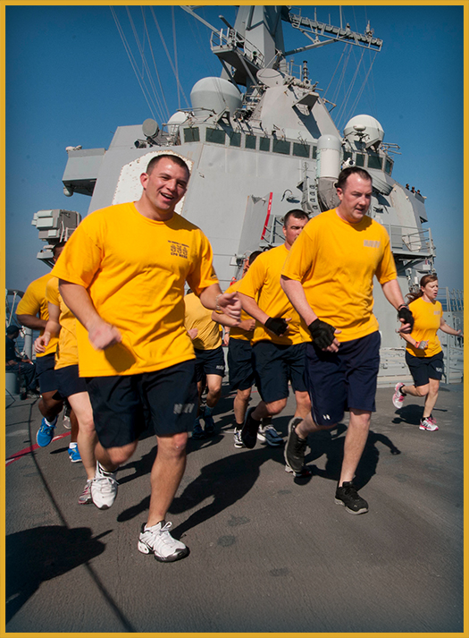
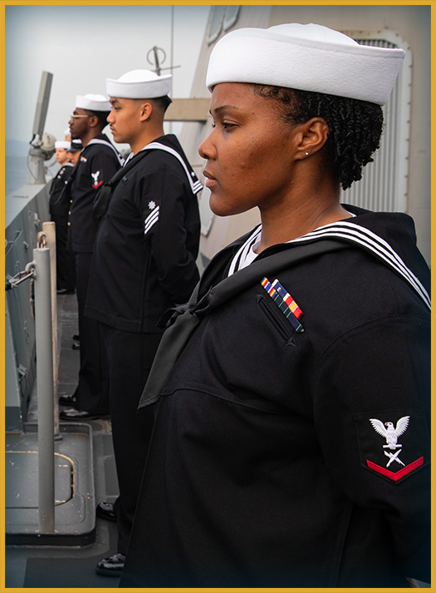
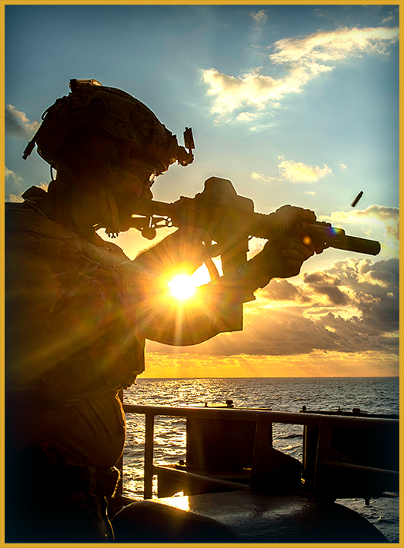
Energy Management
What is energy management?
Notes:
Facilitator Actions:
Display slide.
Discuss how graphics relate to topic.
Monitor the discussions of the Sailors.
Facilitator Content:
Discuss:
What is energy management?
Inform:
Energy management is the theory that each task Sailors interact with has an ideal level of energy that should be used to perform the task. Being under energized can lead to not enough effort, and being over energized can lead to premature burnout. The goal is to find the right balance of energy for each task to achieve optimal performance.
Energy management is using the right amount of energy, for the right task, at the right time.
Discuss:
How can using too little or too much energy lead to poor performance?

Slide 5
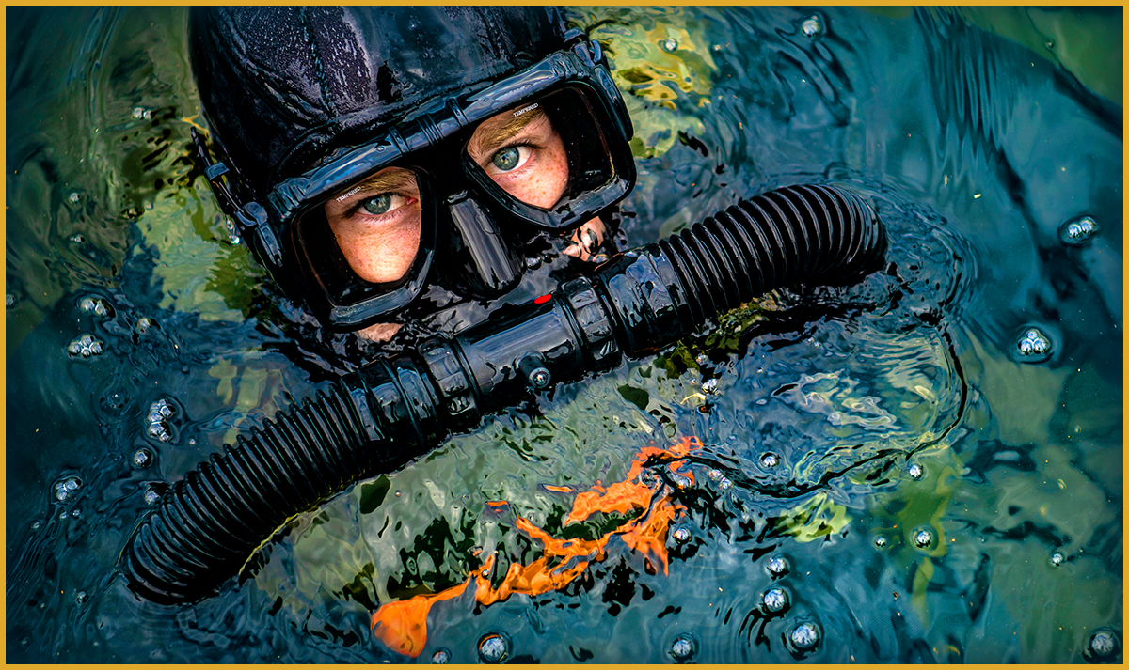
Get in the Zone
The three areas are:
Knowledge of optimum energy required for task
Awareness of current energy level
Ability to alter and adapt energy level
Notes:
Facilitator Actions:
Display slide.
Discuss how graphic relates to topic.
Monitor the discussions of the Sailors.
Facilitator Content:
Discuss:
What do you think it means to be in the zone?
Inform:
When Sailors are performing at peak performance, it is known as being in the zone. Reaching this state requires awareness of the desired energy level necessary to perform the task.
The three areas of awareness are:
Knowledge of optimum energy required for task
This is the knowledge of how much energy is required to perform the task.
Gaining this knowledge may take repetition of the task or formal instruction by leaders.
Awareness of current energy level
Internal awareness can help to determine where the Sailors’ current energy level is.
Reflection and mindfulness can help Sailors to be aware of their current energy levels.
Some individuals will naturally prefer performing with intense energy while others prefer a slow and steady approach.
Ability to alter and adapt energy level
This is the ability to raise or lower the Sailors’ energy level to reach the optimum energy level for the task.
There are many different skills Sailors can use to lower or raise their energy levels.
The skills that are available will depend on the Sailors’ situation. Having different skills readily available will ensure the Sailor can reach and maintain their optimum energy level.
Discuss:
Have you been in the zone before? How were you able to reach it?
What task were you performing?
How did you get energized for the task?
What level of energy did the task require?
How were you able to stay calm and regulate your energy level?
How did you know you were in the zone?

Slide 6
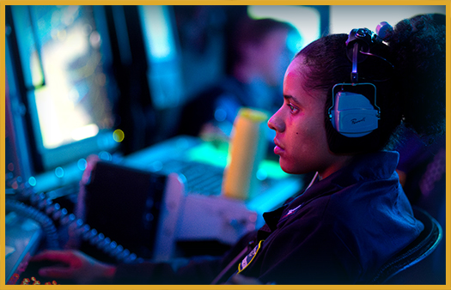
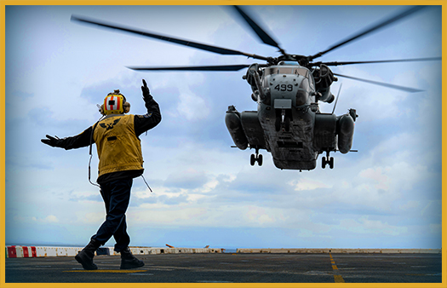
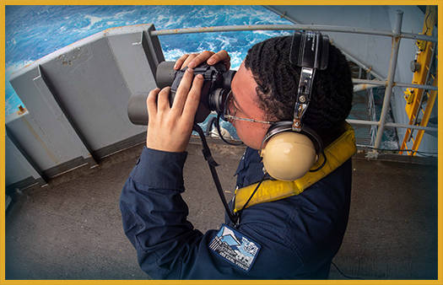

Different Energy Levels
How much energy do you need to perform at peak performance?
Notes:
Facilitator Actions:
Display slide.
Discuss how graphics relate to topic.
Monitor the discussions of the Sailors.
Facilitator Content:
Discuss:
How much energy do you need to perform at peak performance?
Inform:
Different tasks require different amounts of energy to perform them effectively. The importance of the task does not regulate how much energy should be used for optimum performance.
Discuss:
Based on the images shown, do they require more mental focus or physical energy?
Inform:
Actions such as manning a radar while in combat require the Sailor to stay calm and regulate their energy at a lower level to keep full focus and attention on the screen, operate the panel, and successfully relay information to the rest of the bridge.
Whereas, rushing into a fire requires a higher energy level to perform the physically demanding task of manning the hose and wearing heavy gear.
Discuss:
If you are standing in front of a room presenting a topic, what level of energy is required for peak performance?
Do you think the rush of adrenalin mixed with the feeling of anxiety would make it tougher to reach an optimum level of energy?
Inform:
When Sailors are tasked, their brain recognizes the importance of the task. They may feel an emotional response and experience increased stress that triggers higher levels of energy. Being able to lower and manage their energy level is vital for achieving and maintaining peak performance.

Slide 7

Psyching Up and Winding Down
Can you control your energy?
Notes:
Facilitator Actions:
Display slide.
Discuss how graphic relates to topic.
Monitor the discussions of the Sailors.
Facilitator Content:
Discuss:
What are some ways you raise your energy level?
What are some ways you lower your energy level?
Inform:
Psyching Up and Winding Down are two essential strategies for energy management, particularly in balancing physical, emotional, and mental resources throughout the day. Both approaches play critical roles in managing how you feel, think, and act, depending on your goals and needs.
There are multiple techniques to raise and lower energy levels. Some of the techniques are focused on being performed during preparation and others are focused on during execution.
The following are ways Sailors can regulate their energy:
Performance statements
A good performance statement should be brief, instructive, realistic, and helpful.
The effect of performance statements depends on what the Sailor says to themselves and how they say it.
Examples of performance statements are:
Get fierce! Let’s fight!
Be safe, be calm.
Emotions
Emotions can amplify or suppress energy levels.
Performance statements have a direct impact on emotions.
Breathing
When a Sailor alters their breathing pattern, it has a direct impact on their energy level.
Breathing rapidly can raise energy levels.
Breathing slowly can lower energy levels.
Body movement
If a Sailor’s body is at rest, the act of getting their body in motion raises their energy level.
If a Sailor is trying to decrease their energy level, they can stretch their muscles to help release tension.
Music
Music can either be audibly heard or the Sailor can imagine the sound in their head.
Fast-paced, energetic music can raise energy levels.
Slow, relaxing music can help to lower energy levels.
Discuss:
What songs do you listen to if you want to increase or decrease your energy levels?

Slide 8
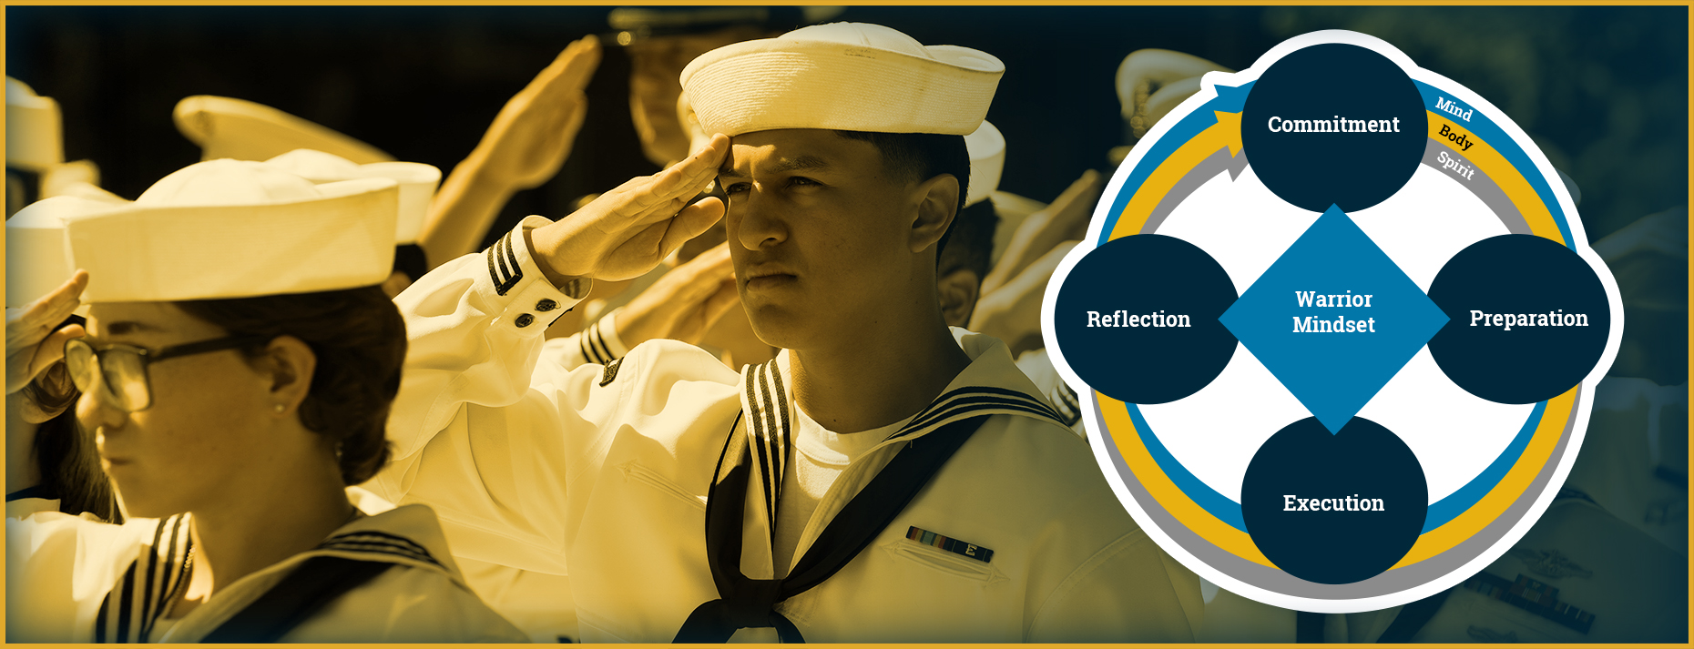
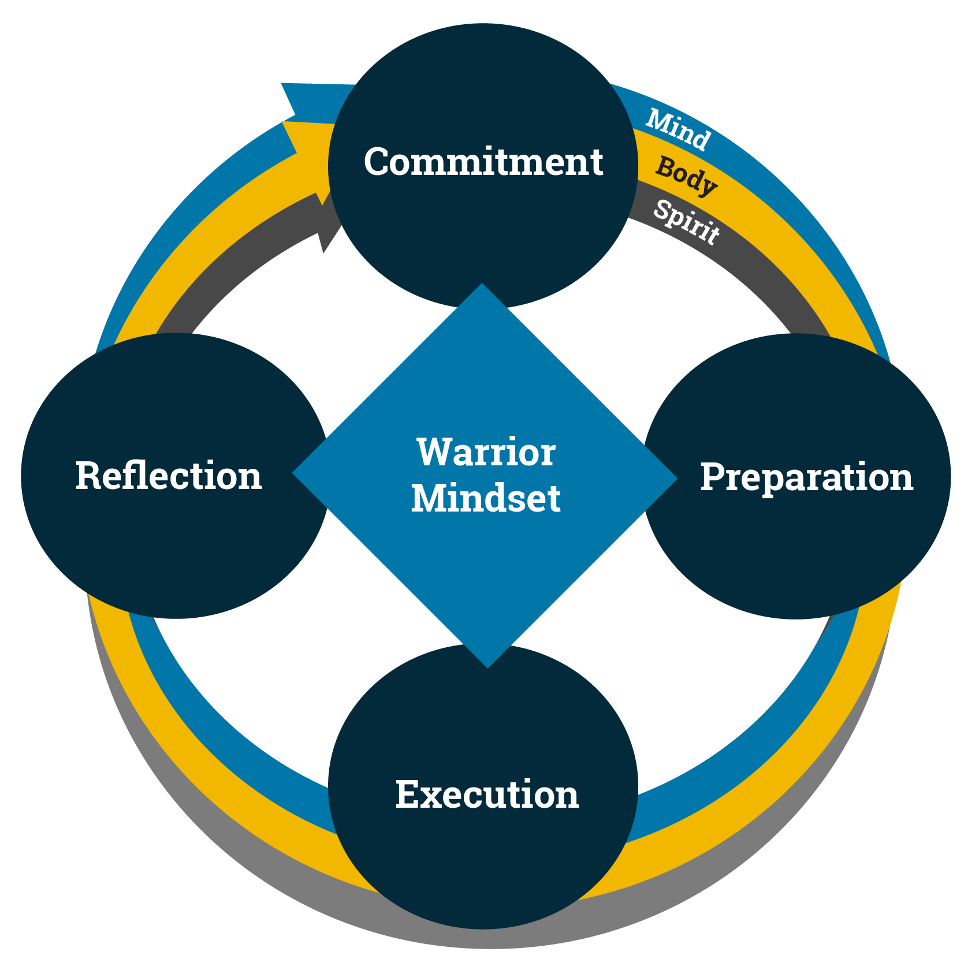
Energy Management and the Warrior Mindset
How is energy management used to maintain a Warrior Mindset?
Notes:
Facilitator Actions:
Display slide.
Discuss how graphic relates to topic.
Monitor the discussions of the Sailors.
Facilitator Content:
Inform:
Energy management is required to maintain a Warrior Mindset and requires discipline, focus, and intentional action to achieve success.
Discuss:
Looking at the graphic, where do you think energy management is most needed in the Warrior Mindset?
Inform:
The following demonstrates the role energy management plays in each of the four areas of the Warrior Mindset:
Commitment
The Sailor’s energy should be focused on their long-term goals and objectives. This means prioritizing tasks that contribute to the Sailor’s purpose and avoiding distractions that drain their energy.
A warrior’s commitment is unwavering. They have a sense of duty and purpose that drives them to show up every day, regardless of obstacles.
Preparation
Intentional preparation is a critical aspect of energy management. The better prepared Sailors are, the more efficiently they can execute.
A warrior prepares mentally, physically, and emotionally for every battle. This involves training, honing skills, and maintaining an unyielding mindset.
Execution
Execution requires continual focused energy and is only possible if Sailors manage their resources wisely.
Execution from a warrior’s perspective is about acting with precision, speed, and discipline.
Reflection
Reflection is essential for energy management because it allows Sailors to assess how effectively they used their energy and determine if it should have been expelled differently.
A warrior consistently reflects on past experiences to learn, adapt, and strengthen their Mind, Body, and Spirit.

Slide 9
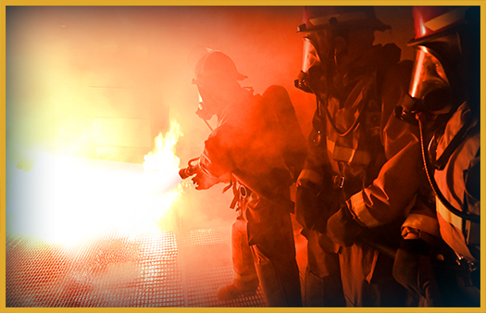
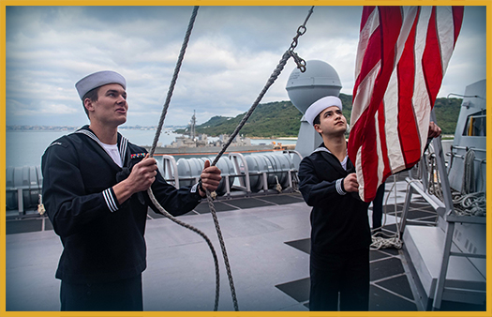
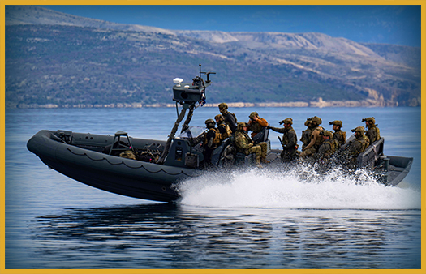
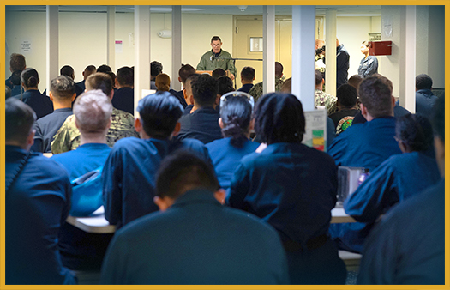
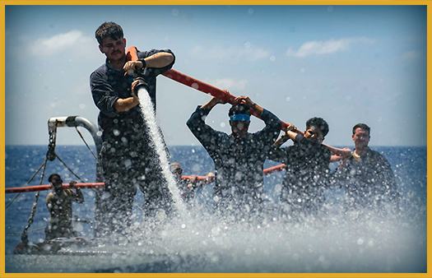
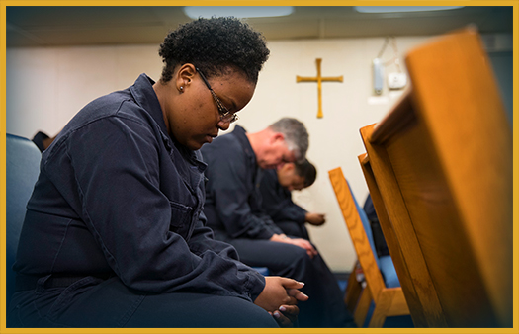
Energy Management Activity
Identify the amount of energy needed.
Notes:
Facilitator Actions:
Display slide.
Monitor the discussion of the Sailors.
Exercise should not exceed 5 minutes.
Facilitator Content:
Inform:
The focus of this activity is to determine how much energy (low or high) is required to perform each of the tasks shown.
Discuss:
Ask the Sailors to review each image and identify the level of energy required to perform each task shown on the screen.
Start from the top left and go through the images left to right.
Review each image and ask the Sailors to raise their hands to identify each level of energy,
Provide feedback based upon their answers.
Ask the Sailors why an image would not require a specific level of energy.
Answers:
Firefighters fighting a fire – high energy
Sailors raising flag on ship – low energy
Navy Sea, Air, and Land (SEAL) Team running drills – high energy
Sailors sitting in an auditorium listening to a speaker – low energy
Sailors cleaning the deck of a ship – high energy
Sailor praying – low energy
Discuss:
What determines the need for a higher level of energy while performing a task?
Could a task go from needing high energy to low energy?
What skills could you apply if you need to go from a high energy level to a low energy level?
Which step of the Warrior Mindset includes determining how much energy is required to complete the task?
Inform:
The expected outcomes of the activity are that Sailors will be able to:
Identify how much energy is required to perform a task.
Determine that some of the tasks can change energy level requirements while they are being performed.
Recognize that some of the tasks cannot be performed with too little or too much energy.

Slide 10

Call to Action
Stay in the zone by managing your energy!
Notes:
Facilitator Actions:
Display slide.
Review topics discussed and ask if there are any questions.
Check Sailor comprehension by providing review questions and/or problems.
Discuss how the call to action supports and encourages Sailors’ post training.
Relate call to action to Warrior Toughness.
Facilitator Content: N/A

Slide 11
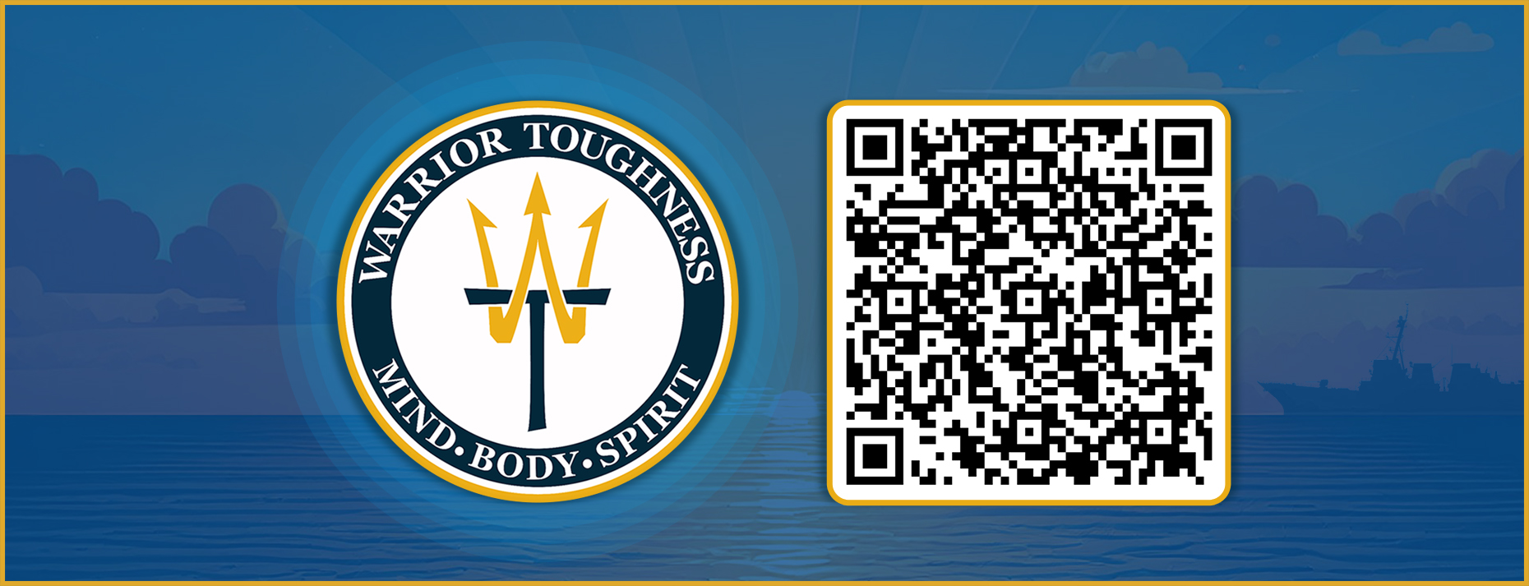
Warrior Toughness QR Code
Notes:
Facilitator Actions:
Display slide.
Facilitator Content:
Inform:
Identify Warrior Toughness QR code.

Slide 12
References
Tools and Resources
Warrior Toughness Placemat
Notes:
Facilitator Actions:
Display slide.
Facilitator Content:
Inform:
Identify tools.
Identify resources.

Slide 13
Glossary
Glossary
Acronym | Term
SEAL | Sea, Air, and Land
WT | Warrior Toughness
Notes:
Facilitator Actions:
Display slide.
Facilitator Content: N/A

